Slide 1
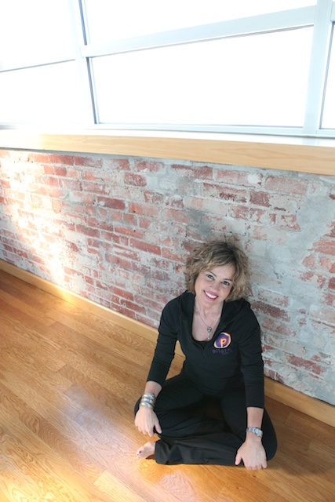

Slide 2
It's as Simple as 1, 2, 3!
1. Reserve your spots. Email info@pilates1901.com
2. Your Guest gets a FREE 1901 Workout.
3.You both get a Fancy Smancy Pilates 1901 Water bottle. Booyah!

Slide 3
Bring a Friend to Any Mat/Basic Class
It's as Simple as 1, 2, 3!
1. Reserve your spots. Email info@pilates1901.com
2. Your Guest gets a FREE 1901 Workout.
3.You both get a Very Cool Pilates 1901 Water bottle. Booyah!

Slide 4
BRING A FRIEND TO CLASS
It's as Simple as 1, 2, 3!
1. Reserve your spots. Email info@pilates1901.com
2. Your Guest gets a
FREE Mat/Basic Class!
3.You both get a Very Cool 1901 Water bottle. Booyah!

Slide 5
BASIC REFORMER
Jump into one of our 7 weekly
Classes soon!

Slide 6
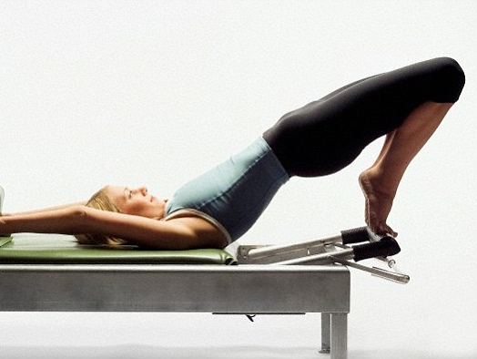
Extend Yourself
YOGA FORMER
Mondays 6:00 pm
Tuesdays 930 am
Fridays 9:30 am

Slide 7
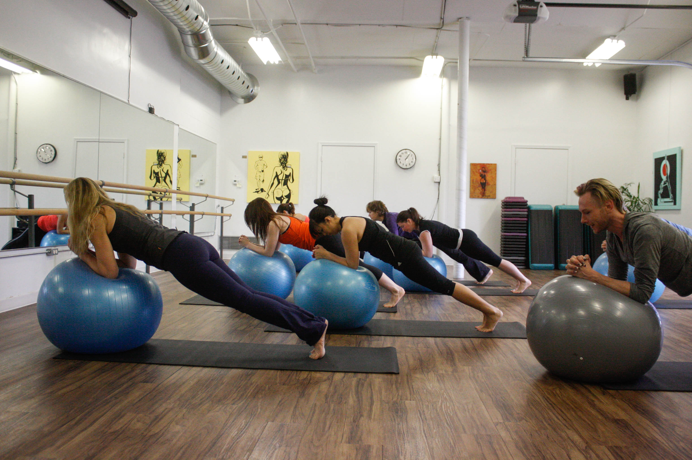
SATURDAY MORNING
Basic Mat 9:00 am
Power Ball 1030 am

Slide 8
TUNE UP YOUR PRACTICE WITH A PRIVATE SESSION
30 & 50 Minute Sessions Available

Slide 9
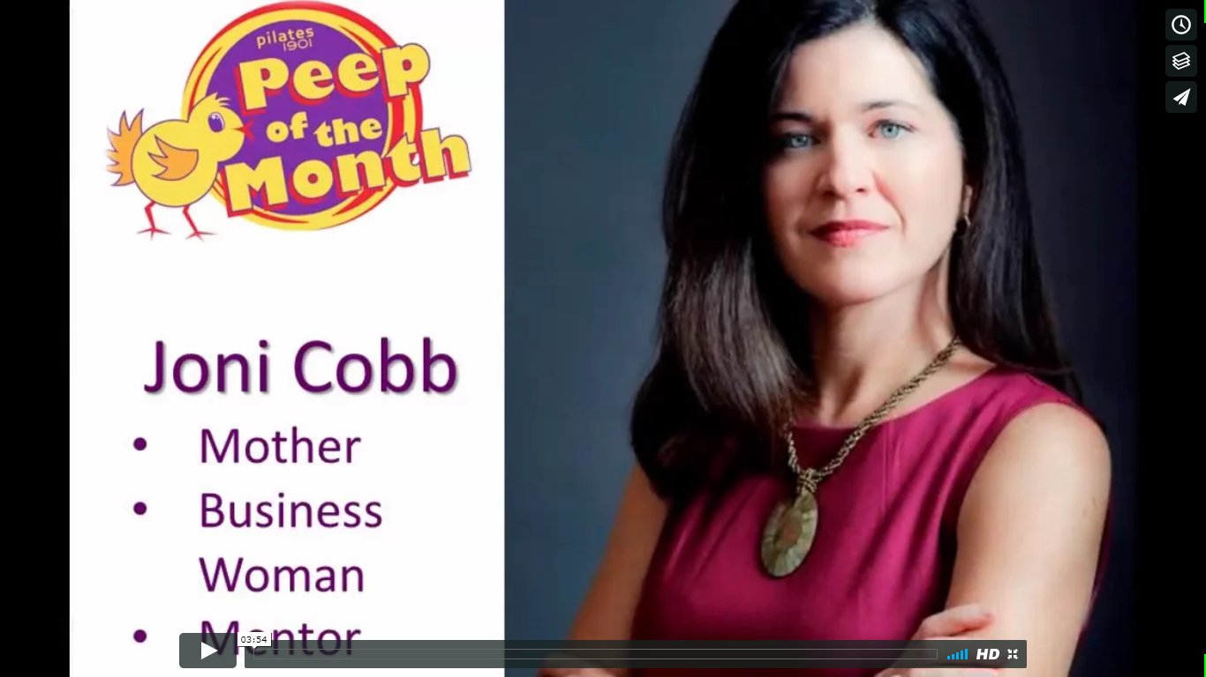
https://vimeo.com/228566990/

Slide 11
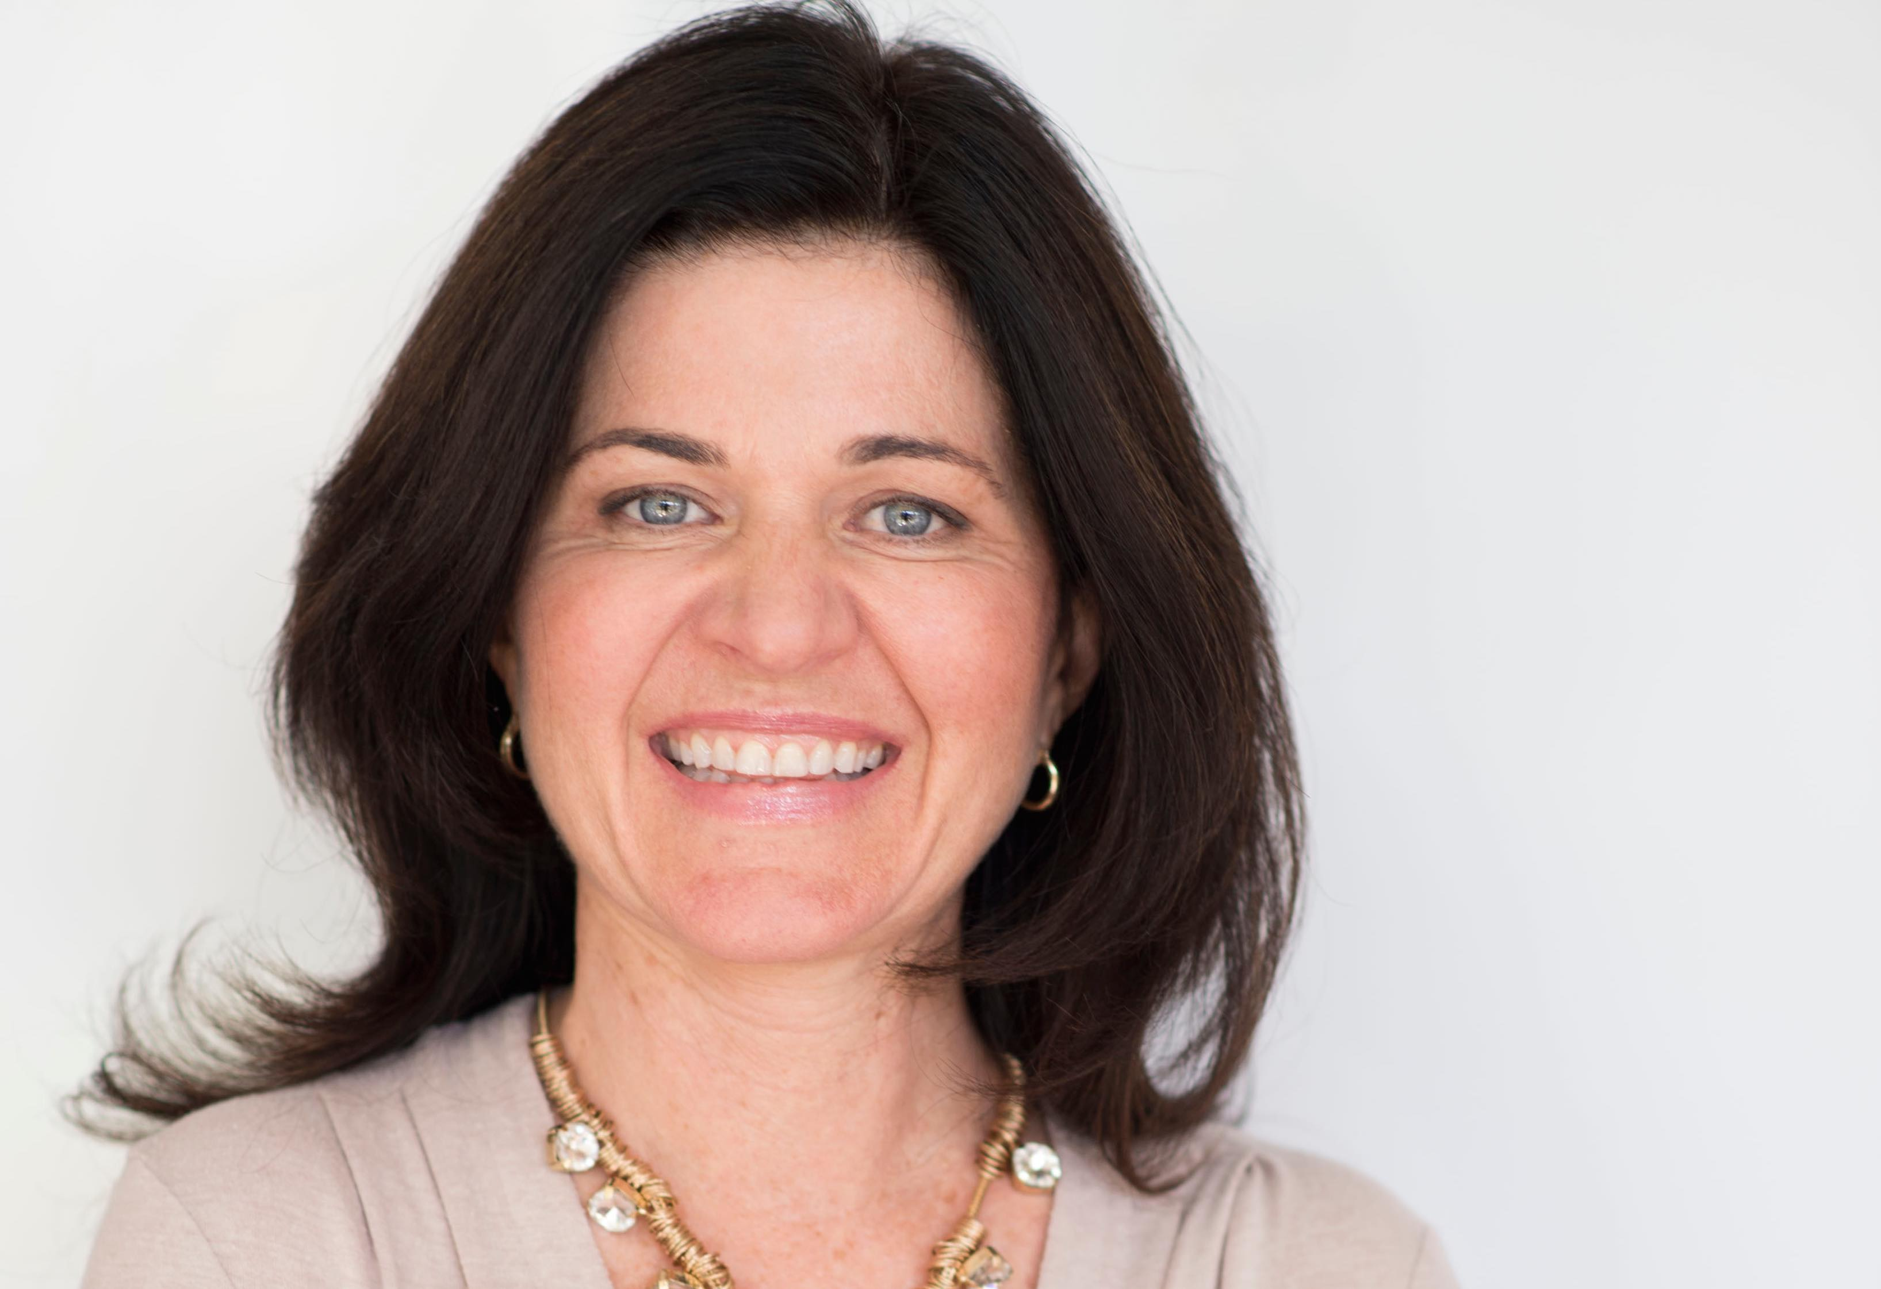
Joni Cobb

Slide 12
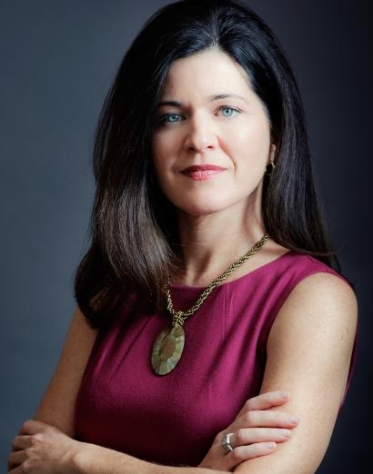
Joni Cobb
Mother
Business Woman
Mentor

Slide 13
Aug 19th
10:00- 11:00 am
Book Now!
Group Assessments
Just $10

Slide 14
$10

Slide 17
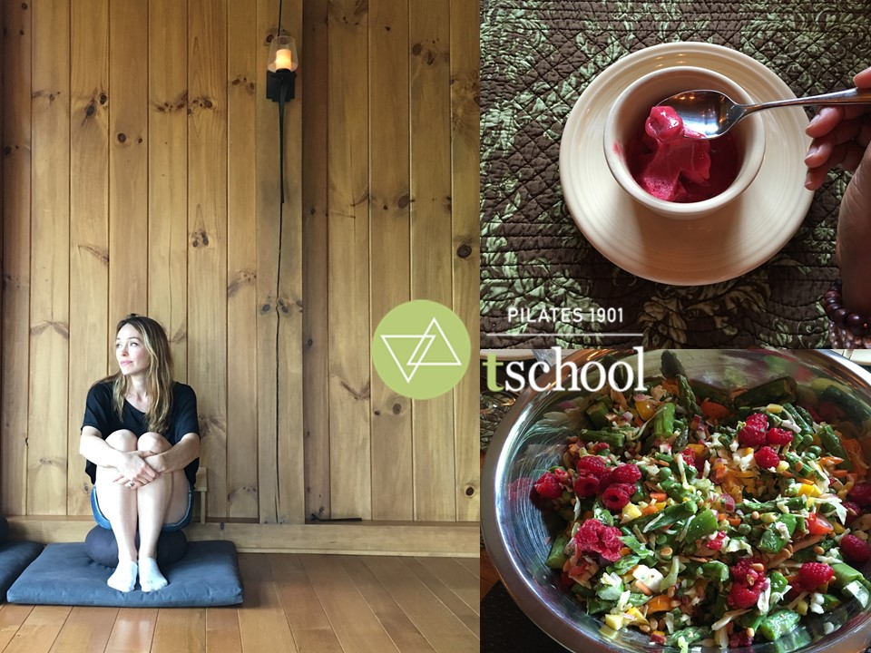
Fall Retreat Dates:
* Friday – Sunday
Sept 22-24th
* Friday – Sunday Nov 10th-12th
^{www.pilates1901.com/retreat}

Slide 20
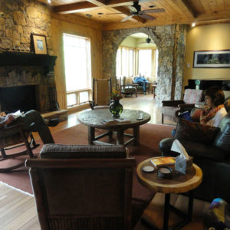

Slide 22
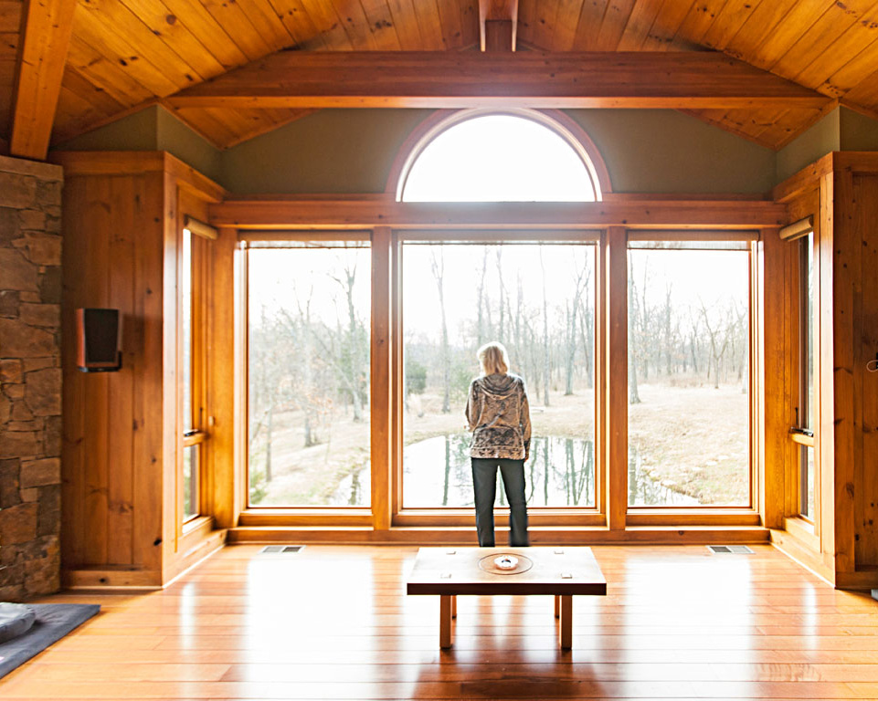

Slide 23
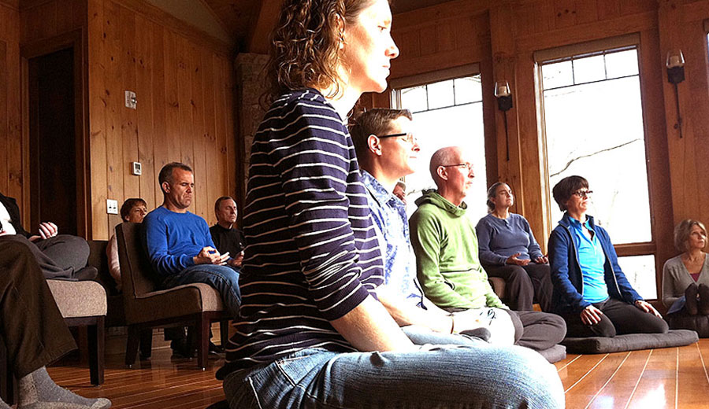

Slide 24
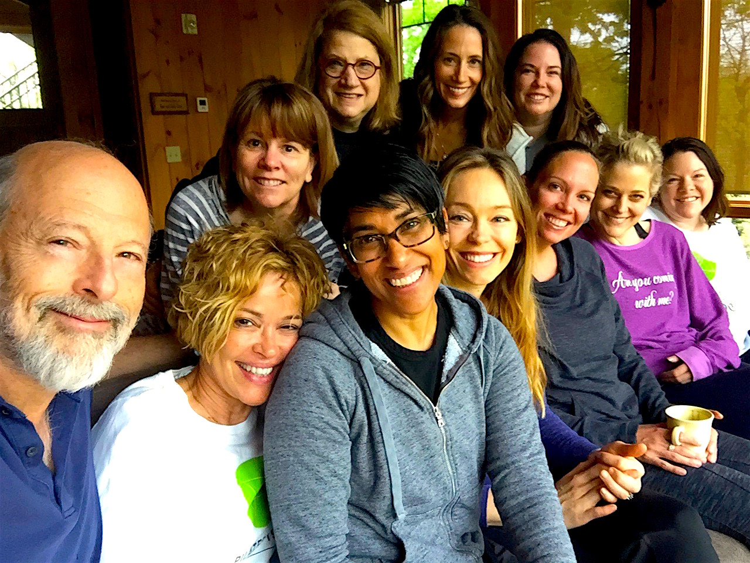

Slide 25
Fall Retreat Dates:
* Friday – Sunday
Sept 22-24th
* Friday – Sunday Nov 10th-12th

Slide 26
Register NOW: www.pilates1901.com/retreat

Slide 27
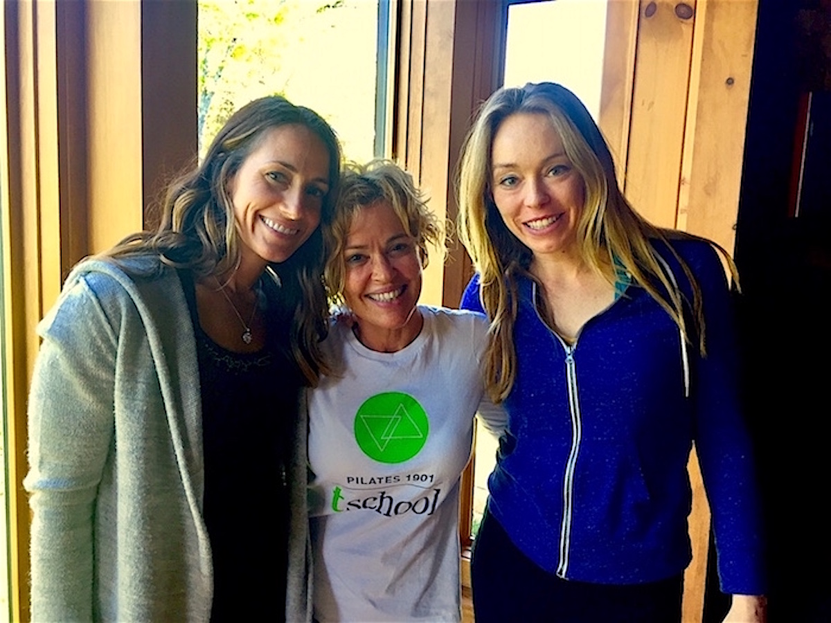
BELIZE 2018
www.pilates1901.com/retreat

Slide 31
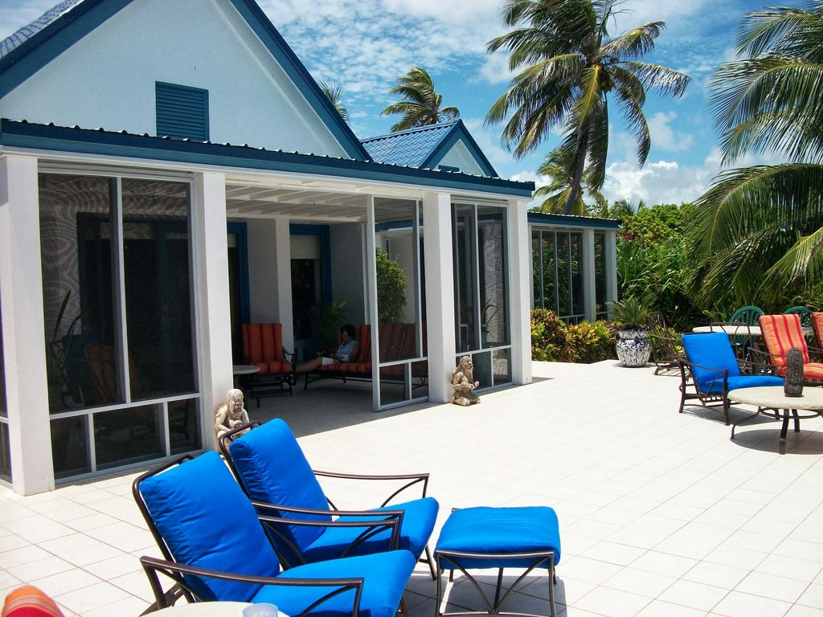

Slide 32
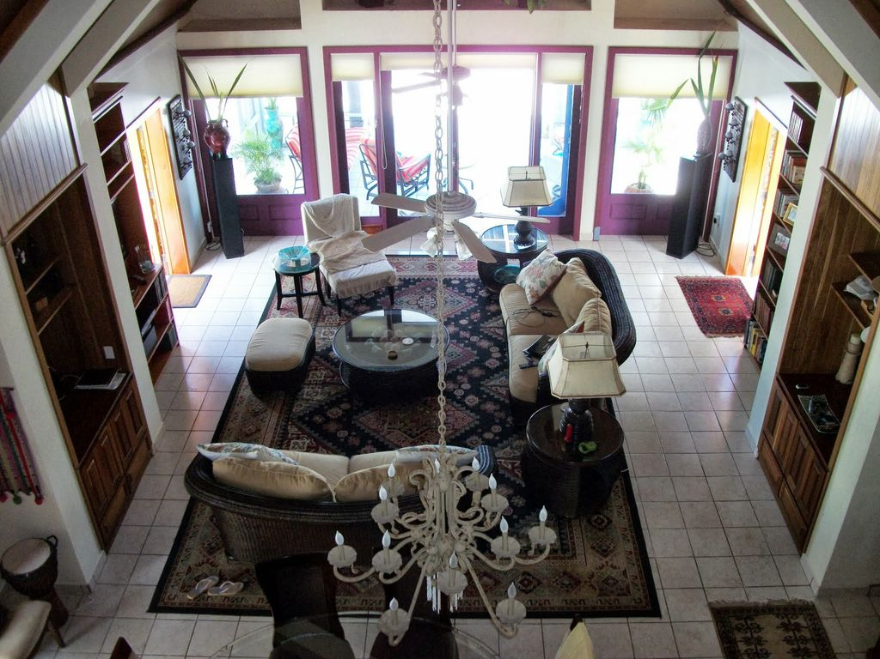

Slide 33
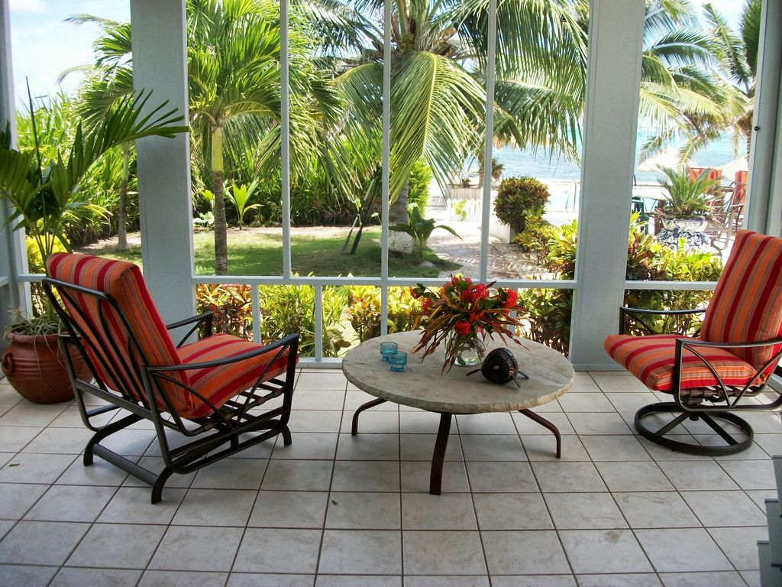

Slide 34
February 14-19th, 2018
Wait List Only

Slide 35
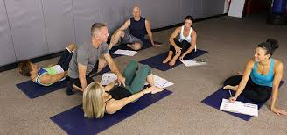
CONTINUING EDUCATION COURSES
October 15, 2017 www.pilates1901.com

Slide 36
Mat Intensive Instructor Training
Coming Fall 2017 www.pilates1901.com

Slide 37
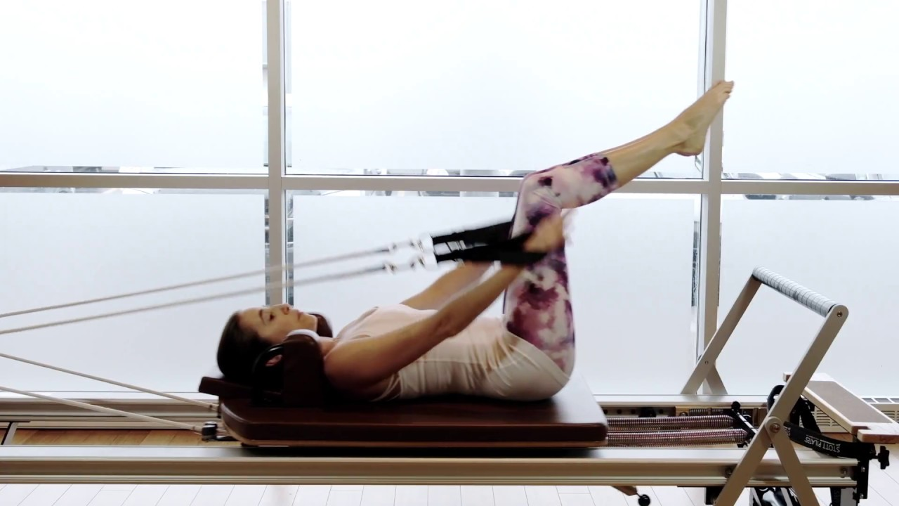
Unlimited
ALL Studio
Class Package!

Slide 39
Serious
FUN!

